Slide 1

Data Exploration in Biology 2
Linear Models

Slide 2
The advantages of linear models
One-Sample t-test and z-test
Independent Samples t-test
Paired Samples t-test
Pearson Correlation
Simple & Multiple Linear Regression
ANOVA (Analysis of Variance)
ANCOVA (Analysis of Covariance)
MANOVA / MANCOVA
Binary Logistic Regression
Binomial distribution
Multinomial Logistic Regression
Ordinal Logistic Regression
Chi-Square Test of Independence
Poisson Regression (Log-Linear Models)
Negative Binomial Regression
etc.
A single conceptual framework
Mix numeric and categorical variables seamlessly
Estimate the effect of one variable on another (interactions)
Automatically provides estimates with SE and 95% CI

Slide 3
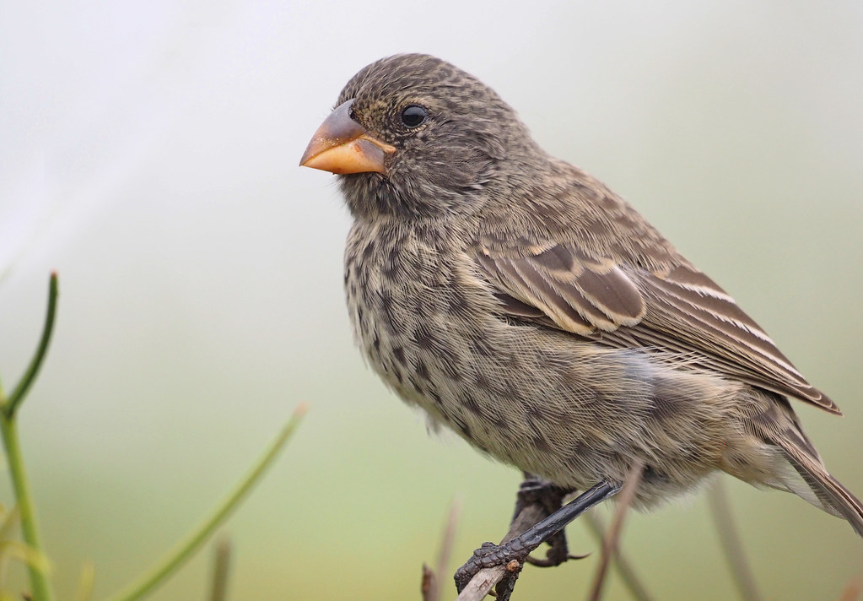
Ground finch beak depths
Did ground finch beak depths evolve during a 1977 drought and by how much?

Slide 4
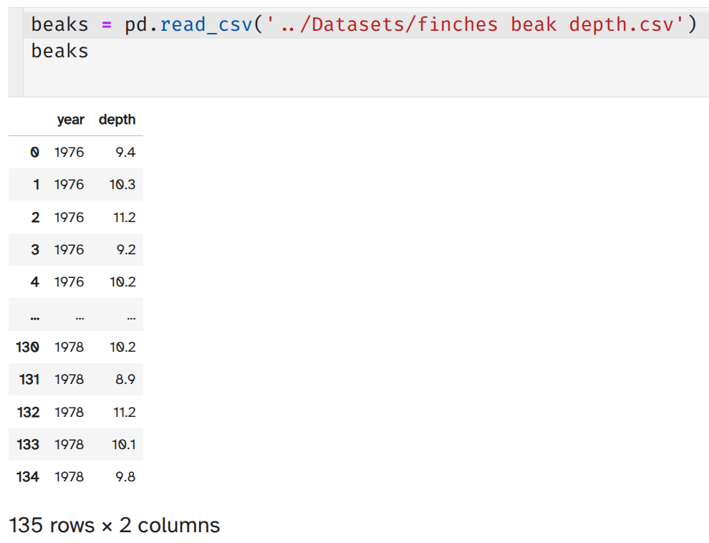
Each row is an observation of a single finch
"year" is a categorical variable
It has two categories (levels) of 1976 and 1978
"depth" is a continuous numerical variable
It is measured to the nearest tenth of a mm

Slide 5
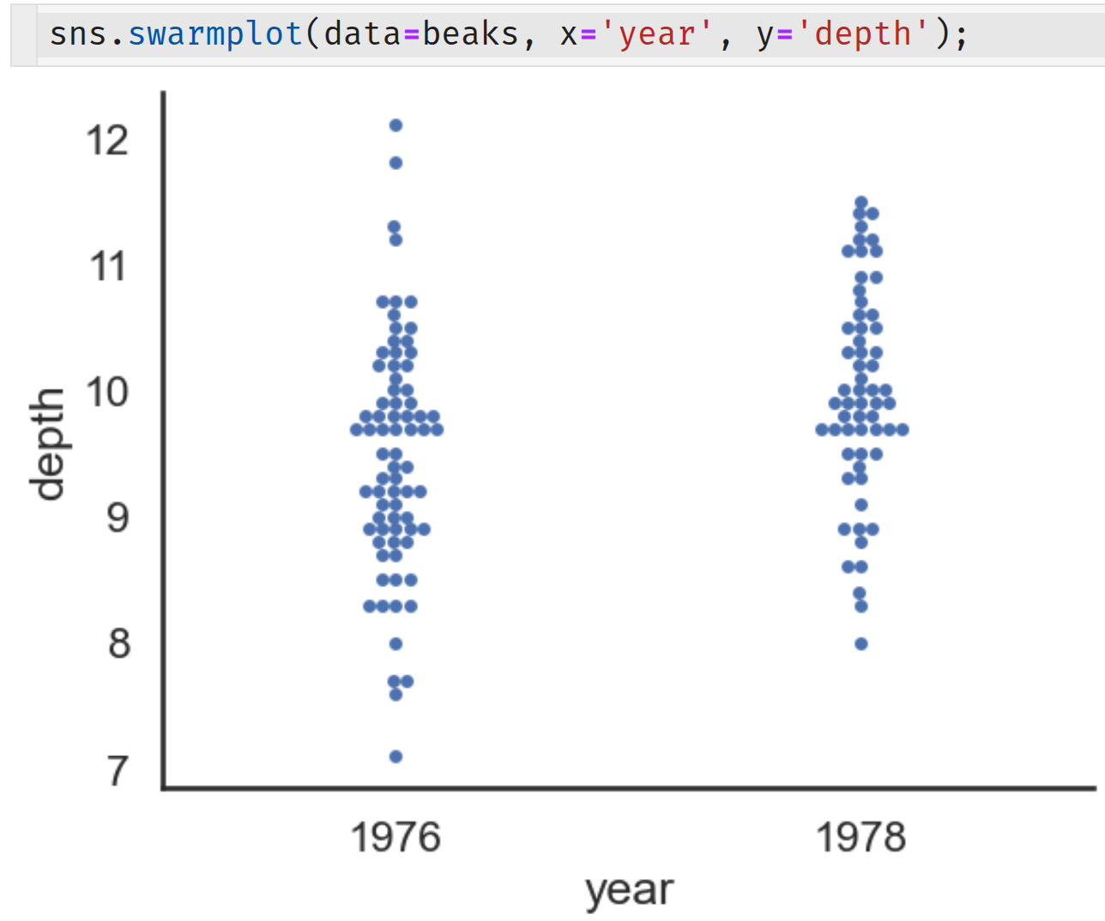
A swarm plot is good for this dataset because there are few data and we can see how the individual data are distributed
0.494 mm
Response variable
9.982 mm
9.488 mm
Each circle is an observation of a single finch
How compatible are these data with the null hypothesis of no difference in beak depths between 1976 and 1978?
Explanatory variable

Slide 6
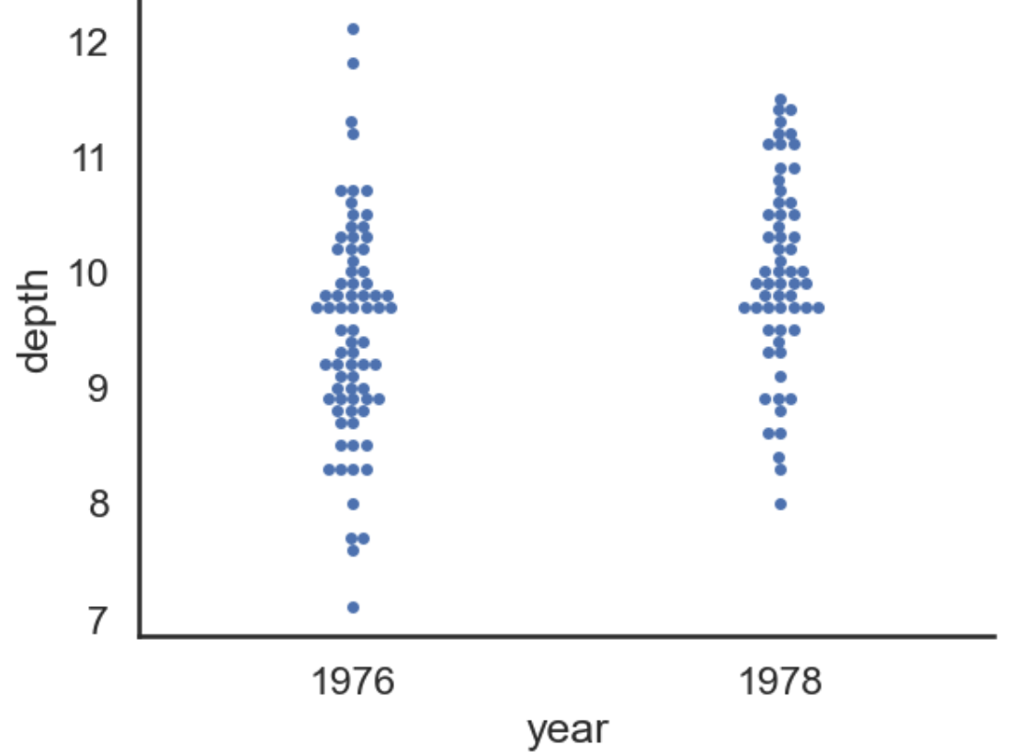
How we do this on the computer:
Modelling the data
A model tells us how the response and explanatory variables are related
“Mean beak depth of ground finches is related to the year they were measured”
Model formula: depth ~ C(year)
"C(year)" tells python to treat "year" as categorical rather than numerical

Slide 7
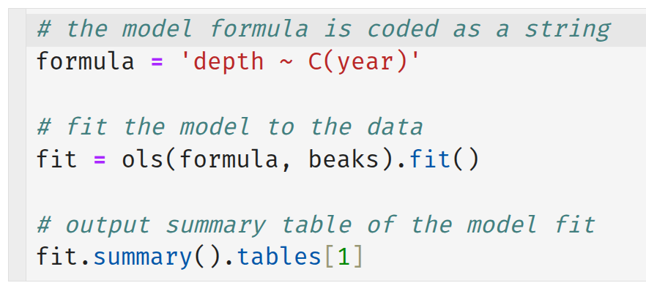
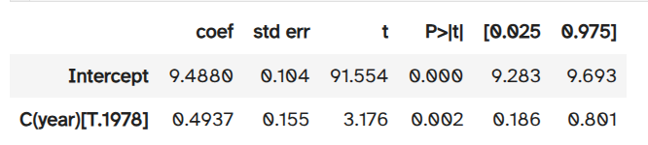
Modelling the data
Code model formula
Fit model to data
Output results

Slide 8
t test of whether 0.49 mm is significantly different from zero
P = 0.002
Data are incompatible with the null hypothesis of no difference
Therefore, 0.49 mm is significantly different from zero
0.494 mm
9.982 mm
9.488 mm

Slide 9
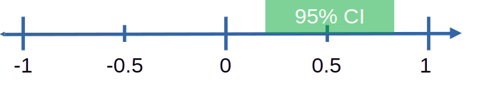
The 95% confidence interval tells us how precise our estimate of the difference in mean beak depths is
Because the 95% CI does not contain zero, the difference is considered "significantly" different from zero
When p > 0.05, the 95% CI contains zero
When p < 0.05, the 95% CI does not contain zero

Slide 10
Report the outcome of the test
"There is a statistically significant difference of 0.49 mm (95% CI [0.19, 0.80] mm) in ground finch beak depths between 1976 and 1978 (t₁₃₃ = 3.2, P = 0.002)."

Slide 11
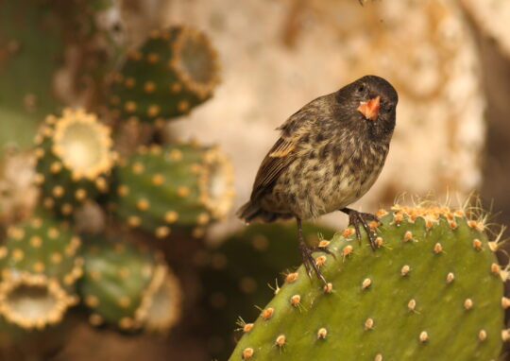
Multivariable linear models
Ground and Cactus finch beak depths
Did ground and cactus finch beak depths evolve during a 1977 drought and by how much?

Slide 12
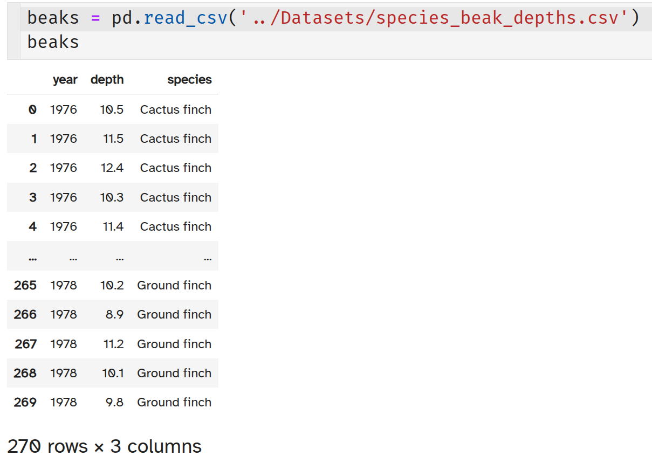
"species" is a categorical variable
It has two levels of "Cactus finch" and "Ground finch"
One response variable: "depth"
Two explanatory variables: "year" and "species"
Explicitly set "year" to categorical to plot correctly

Slide 13
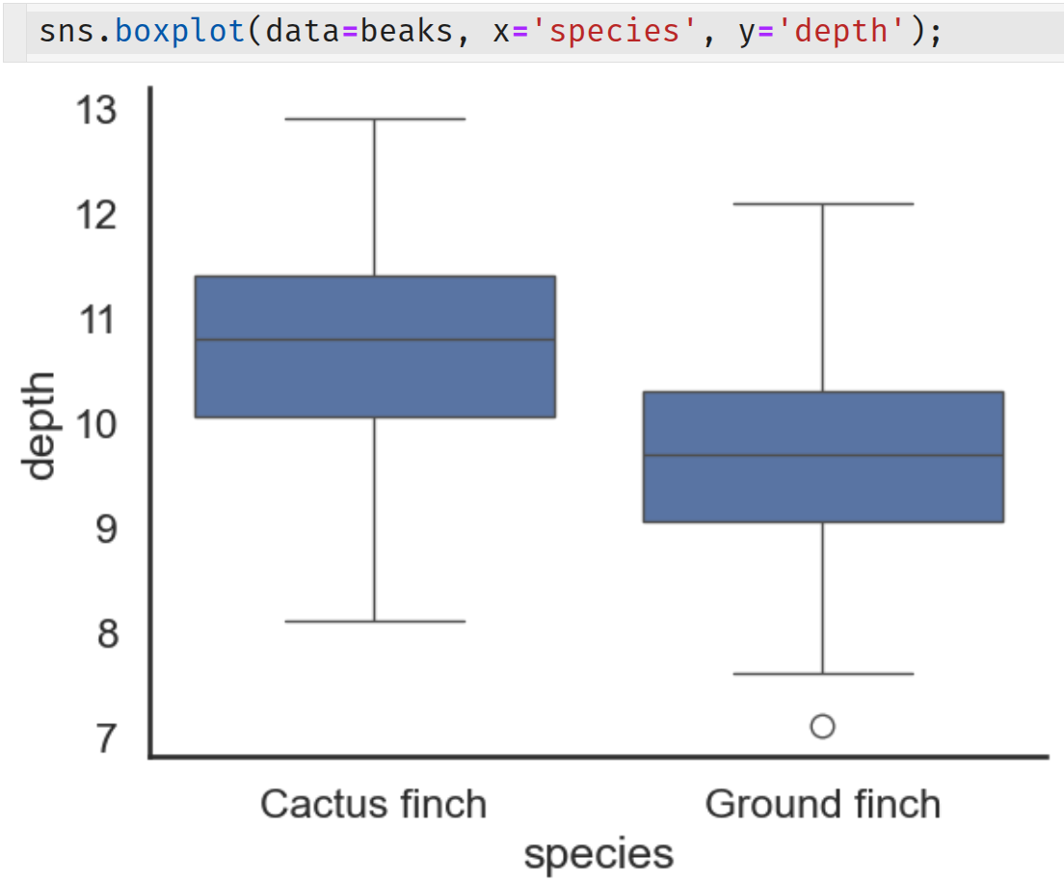
Ignoring "year" for now
Cactus finch beak depths are about 1 mm longer than Ground finch beak depths on average
Response variable
Explanatory variable

Slide 14
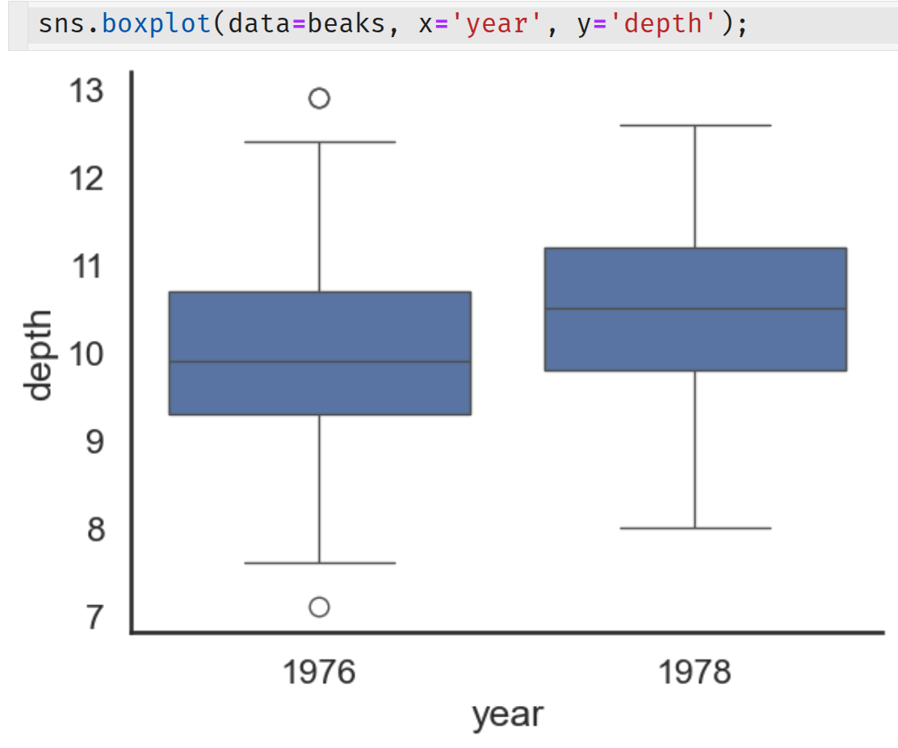
Now ignoring "species"
Beak depths are about 0.5 mm longer in 1978 than in 1976 on average
Response variable
Explanatory variable

Slide 15
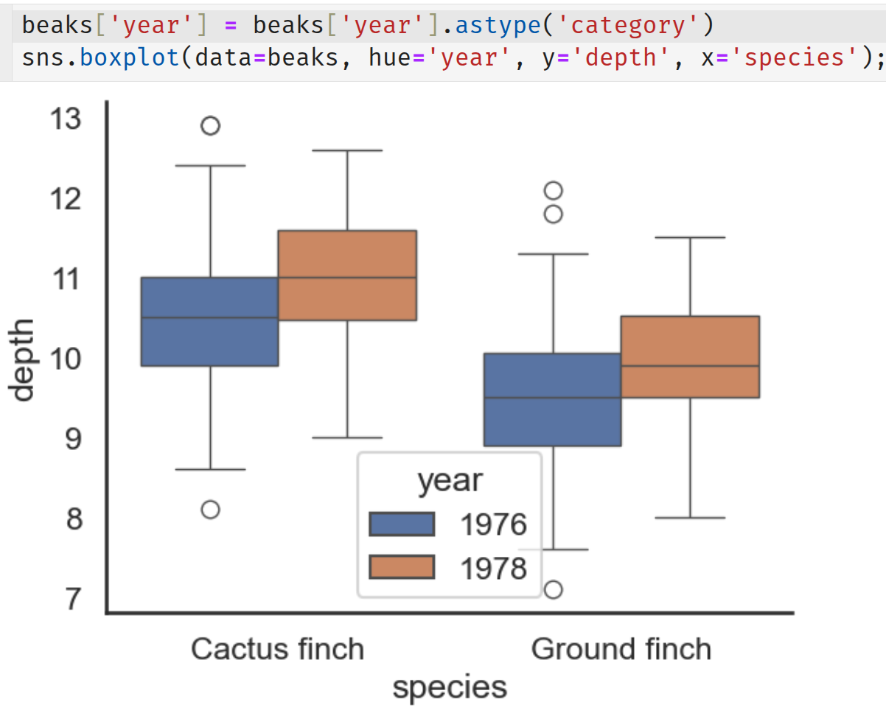
Include "year" and "species"
The change in beak depths from 1976 to 1978 appears to be about 0.5 mm in both species
Response variable
Second explanatory variable
First explanatory variable

Slide 16
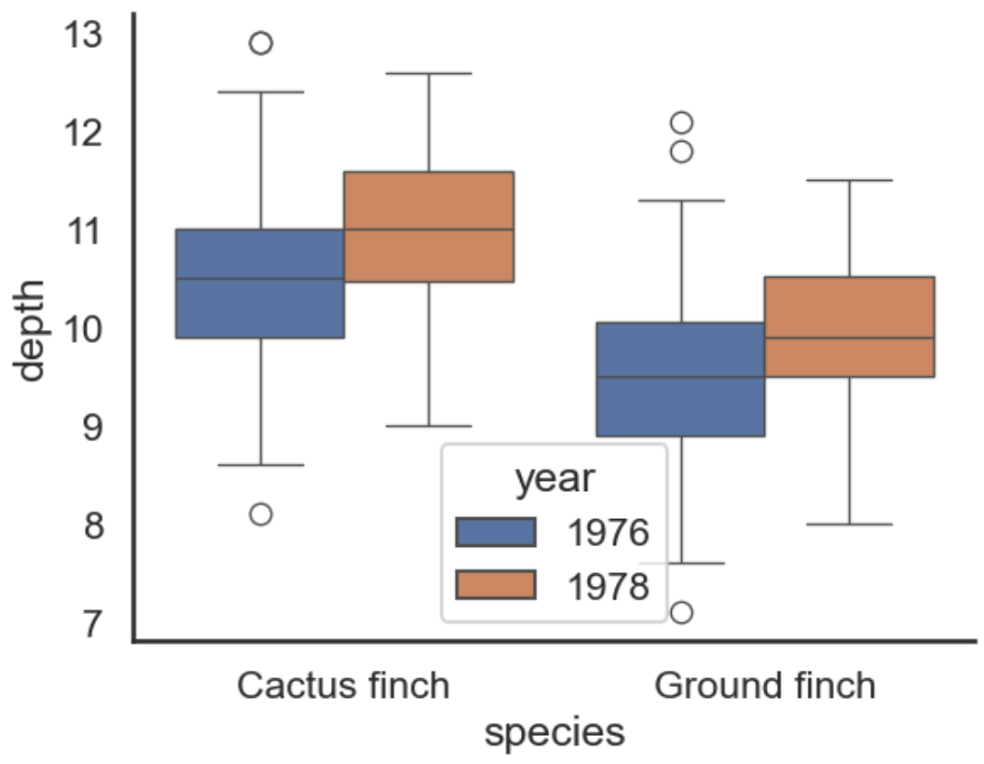
How we do this on the computer:
Modelling the data
A model tells us how the response and explanatory variables are related
+ means "and"
“Mean beak depth of finches is related to the year they were measured and the species”
Model formula: depth ~ C(year) + species

Slide 17
Reference levels
Each explanatory categorical variable has a reference level
By default this is the first alphabetically or numerically
Variable | Reference level | Comparison level
year | 1976 | 1978
species | Cactus finch | Ground finch
Reference: everything else is compared to 1976, Cactus finch

Slide 18
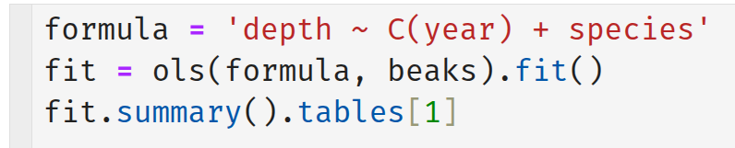
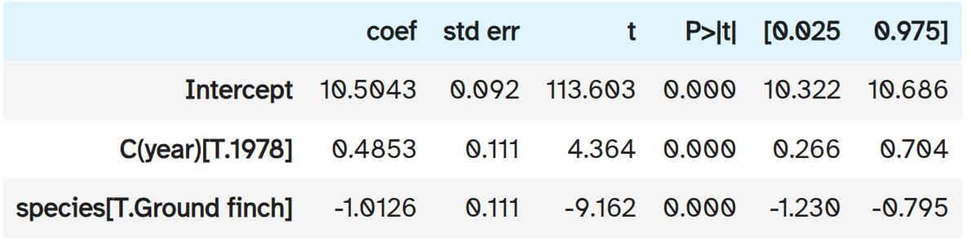
Modelling the data

Slide 19
Reference is the Intercept
Everything else is compared to this
Mean cactus finch beak depth in 1976 was 10.5 ± 0.09 mm

Slide 20
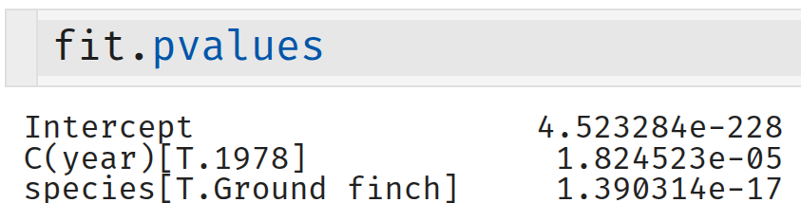
Difference between 1976 and 1978 is 0.49 ± 0.11 mm
Significantly different from zero
P = 1.8 x 10⁻⁵

Slide 21
Difference between Cactus and Ground finches in 1976 is 1.01 ± 0.11 mm
Significantly different from zero
P = 1.4 x 10⁻¹⁷

Slide 22
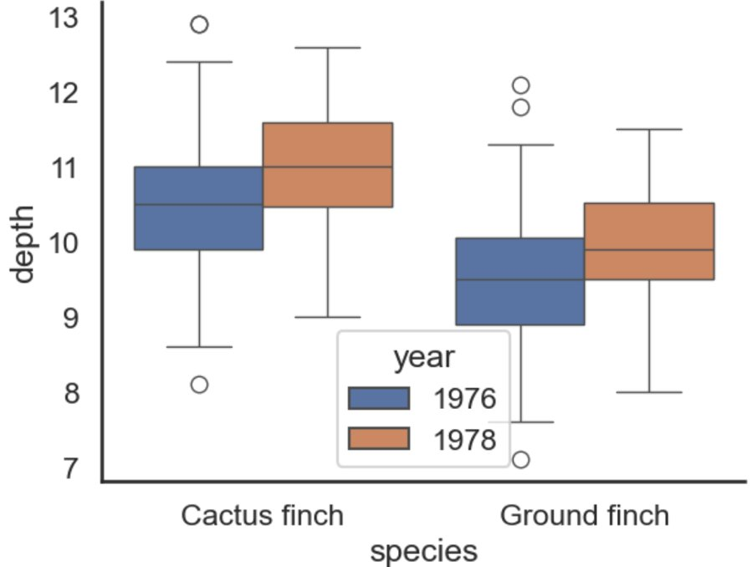
Interactions between variables
Did the increase in beak depths differ between species?
We have assumed that beak depths increased equally for both species from 1976 to 1978
If this assumption is not true then there is an interaction between year and species

Slide 23
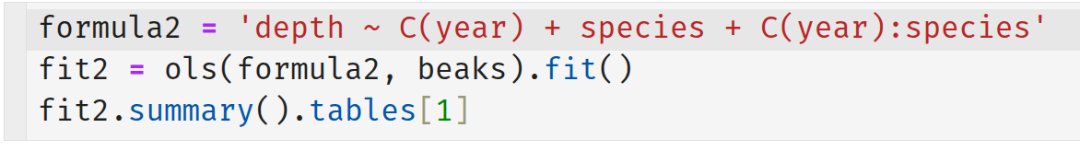
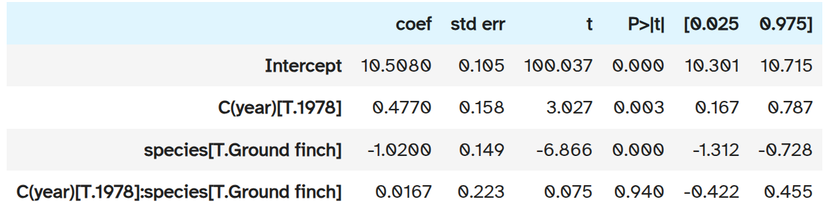
Modelling the data
P = 0.94, data are compatible with the null hypothesis of no interaction
  beak depth change was the same for both species
The model without the interaction is the preferred model

Slide 24
Report the outcome of the test
"In 1976, Cactus finch beak depths were 10.5 ± 0.9 mm (mean ± SEM), Ground finch beak depths were 1.0 ± 0.1 mm shorter (t₂₆₈ = 9.2, P = 1.4x10⁻¹⁷). By 1978, beak depths of both species had increased equally by 0.49 ± 0.11 mm (t₂₆₈ = 4.4, P = 1.8x10⁻⁵)."
Could have used 95% CI instead of SEM. Chose whichever one you want, but specify which one in the text.

Slide 25
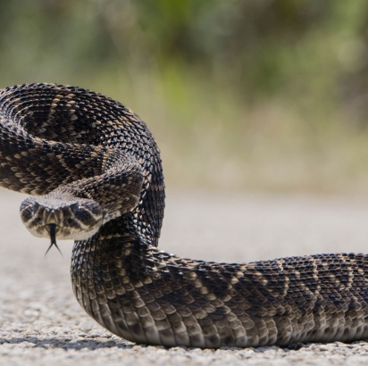
Rattlesnake temperatures whilst eating
Scientists* wanted to know how much rattlesnake temperature changes when digesting meals of different sizes.
They measured weight of meal relative to weight of the rattlesnake and the maximum change in temperature during digestion relative to pre-meal temperature.
*Tattersall et al. (2004)

Slide 26
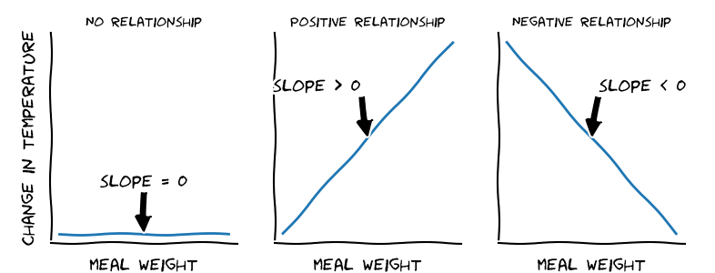
Rattlesnake temperatures whilst eating
Is there a relationship between the size of a rattlesnake’s meal and it’s change in temperature?
And, if so, what is the numerical relationship?

Slide 27
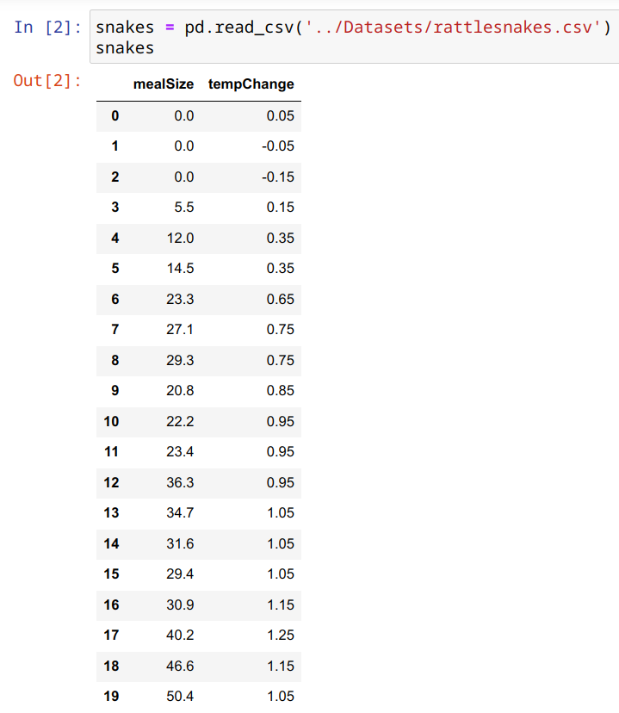
Each row is an observation of a single rattlesnake
“mealSize” is the weight of the meal relative to the weight of the rattlesnake recorded as a percentage (e.g., 50% means the meal was half the weight of the snake)
“tempChange” is the change in temperature measured in degrees Celsius
“mealSize” is the explanatory variable
“tempChange” is the response variable

Slide 28
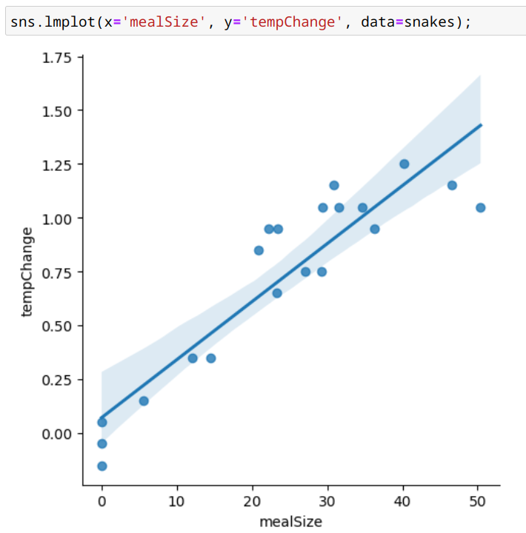
A scatter plot is the best plot for examining the relationship between two numerical variables
The seaborn lmplot() produces a scatter plot and, in addition, plots the fit of the model:
tempChange ~ mealSize

Slide 29
Each blue circle is a measurement on one rattlesnake
The blue line is the fit of the model. It is called a regression line
It is the estimated mean temperature change against meal size
(e.g., a meal size of 50% causes an estimated temperature change of 1.4ºC, on average)
The blue band is the 95% CI of the estimated mean
It indicates the uncertainty in the estimated mean
There is a clear positive relationship between meal size and temperature change
1.4°C

Slide 30
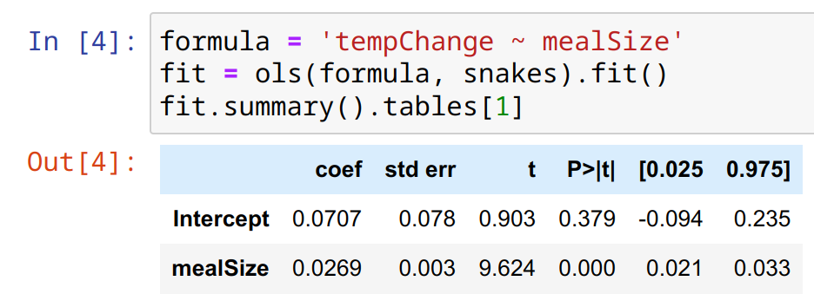
The model
“Temperature change is related to meal size”
tempChange ~ mealSize

Slide 31
Intercept is not significantly different from zero (p = 0.379, 95% CI contains zero)
Makes sense: no meal implies no change in temperature

Slide 32
Slope is 0.0269 ± 0.003 °C
fit.values gives P = 1.6x10⁻⁸
Data are incompatible with the null hypothesis that the slope is zero
Don't really need statistics to tell you that, but the numerical estimates with errors are important

Slide 33
The numerical relationship between meal size and temperature change
Mean temperature change = intercept + slope x meal size
0
0.027
Mean Temperature change (in °C) = 0.027 x meal size (in %)

Slide 34
Report the outcome of the test
"There is a statistically significant rise in rattlesnake body temperature of 0.027 °C (95% CI: [0.021, 0.033] °C) for every 1% increase in meal size relative to rattlesnake body weight (t₁₈ = 9.6, P = 1.6 x 10⁻⁸)."

Slide 35
What to take away from this lecture
Linear models replace many (but not all) traditional statistical tests in a single unified framework.
They are more flexible and more powerful the traditional tests.
We have only scratched the surface of what they can do.
They are common in some areas of biology (e.g., evolution and ecology) and less common in others (e.g., immunology)

Slide 36
Class 11 and Workflow Notebooks
Work through Class_11.ipynb
Workflow Notebooks
workflow_ground_finch.ipynb
workflow_two_finch_species.ipynb
workflow_rattlesnakes.ipynb
walk through the examples in the lecture in more detail.
Use them to answer the questions in the Class 11 notebook

